Slide 1
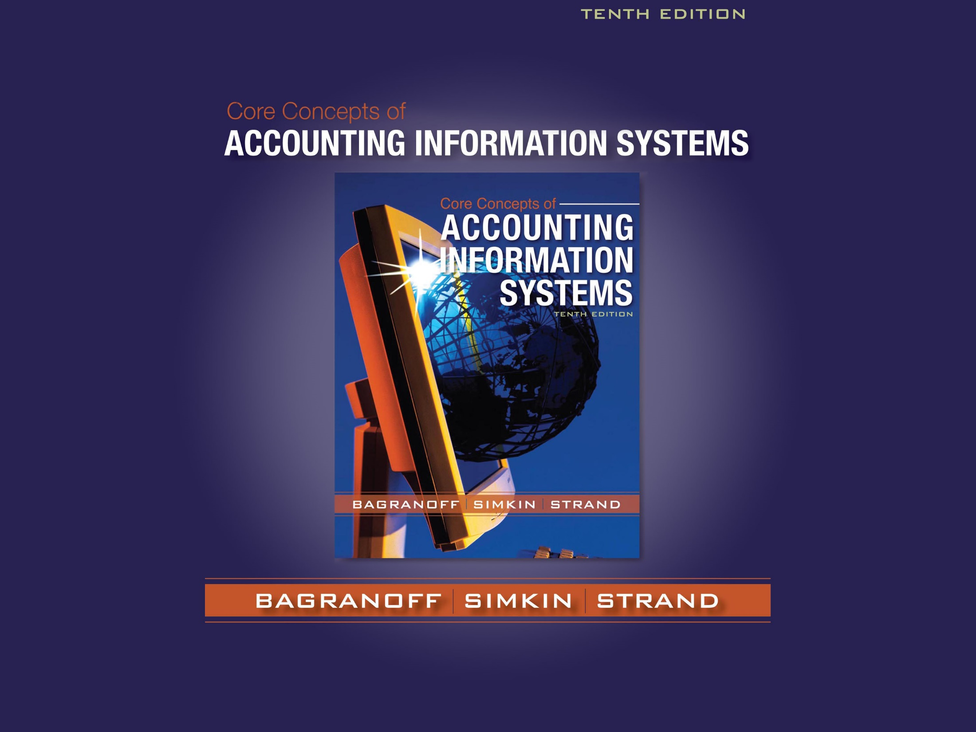

Slide 2


Chapter 1
Accounting Information Systems and the Accountant
Introduction
Accounting Information Systems (AIS)
New Features in AIS
Accounting and IT

Slide 3
Chapter 1
Accounting Information Systems and the Accountant
Careers in Accounting Information Systems
AIS at work - Planning for disaster
Summary

Slide 4


Introduction
Application of information technology (IT)
to accounting systems
  financial accounting,
  managerial accounting,
  auditing,
  taxation, and
Study of accounting information systems
for understanding
  business processes,
  computerized software, and
  information flows that are all part of AIS.

Slide 5
Introduction
Increase in career opportunities with
  minimum level of computer proficiency
  accounting skills combined with computer knowledge
  advanced computer skills in accounting jobs
  awareness of new developments in the field.

Slide 6


The Information Age
Information in this age is
  produced very quickly,
  analyzed efficiently, and
  distributed effectively.
Knowledge workers
  constitute the labor force in this age.
The Internet
  is a major contributor in the information age.

Slide 7

Information Systems(IS)
A System
  consists of interacting parts or components,
  is set up to achieve one or more goals.
An Information System
  is a set of interrelated subsystems,
  works to collect, process, store, transform, and
  distribute information,
  helps to plan, make decisions, and control processes.
A Firm/Company
  depends on information systems to stay competitive.

Slide 8
The Accounting Field
The Accounting Field includes
  financial accounting,
  managerial accounting, and
  taxation
The Accounting System of old is the
  Management Information System (MIS)
  which provided
      financial information and
      nonfinancial information

Slide 9
AIS: At the Intersection of Accounting and IS
Accounting
  financial accounting,
  managerial accounting, and taxation
Information Systems
  collect, process, store, transform, and distribute
Accounting
Information
Systems

Slide 10

Accounting Information Systems
An Accounting Information System (AIS)
  Collection of data and processing procedures
  Creates needed information for users.
The AIS today should be
  an enterprise-wide information system,
  focused on business processes.

Slide 11
Accounting Information Systems
AIS don’t just support accounting and finance business processes. They often create information that is useful to non-Accountants.

Slide 12
An Accounting Information System
Data
Repository/
Files,
Databases,
etc.
Inputs: Collection of Data/Information from
Internal/External sources
Processes: Sorting, Organizing,
Calculating
Outputs: Distribution of Information for Internal/
External Decision Makers

Slide 13
An Accounting Information System
AIS for non-accounting functions of a business
Finance: cash forecasts and actual payment and receipt information
Marketing: Sales, summary analyses, cost information, and sales forecasts
Human Resources: payroll analyses( including employee benefit information) and projections of future personnel costs
Production: inventory summaries and product cost analyses

Slide 14
An Accounting Information System
Question
Which of the following is NOT true about accounting information
systems (AISs)?
a. All AISs are computerized.
b. AISs may report both financial and nonfinancial information.
c. AISs, in addition to collecting and distributing large amounts of data and information, also organize and store data for future uses.
d. A student who has an interest in both accounting and IT will find many job opportunities that combine these knowledge and skills areas.

Slide 15

Data versus Information
Data
raw facts about events that have no organization or meaning
Information
data that have been processed and
made meaningful to users
Notes:
Ask the students to give examples of data and information
* Information can also become data for further processing

Slide 16

MIS versus AIS
A Management Information System provides
to internal users (management)
  financial information and
  nonfinancial information.

Slide 17
MIS versus AIS
The Accounting Information System
provides to both external and internal users
  financial information
Now, the two systems overlap
to provide the same information
focusing on business processes.

Slide 18
MIS versus AIS
MIS
Financial
Nonfinancial
To internal
users
MIS
systems
overlap
AIS
to provide the same information
to focus on business processes
AIS
Financial
To internal
& external users

Slide 19
MIS versus AIS
Question
With respect to computerized AISs, computers:
a. Turn data into information in all cases.
b. Make audit trails easier to follow.
c. Cannot catch mistakes as well as humans.
d. Do not generally process information more quickly than humans.

Slide 20

Accounting in the
Information Age
Financial Accounting
Managerial Accounting
Auditing
Taxation

Slide 21
New Features in AIS
AIS has several new applications today:
In countering terrorism AIS is using banking systems to trace the flow of funds and materials across international borders.
In preventing accounting scandals AIS is helping firms to comply with the Sarbanes-Oxley Act of 2002.
AIS has benefited from the use of
WI-FI Technology

Slide 22
Recent Accounting Scandals
The following is a list of recent accounting scandals that were reported:
Enron 2001
Imclone 2001
Arthur Andersen 2001
Merrill Lynch 2002
Tyco 2002
Adelphia 2002
Global Crossing 2002
Parmalat 2003
NYSE 2003
WorldCom 2003
HealthSouth 2003

Slide 23

The Sarbanes-Oxley Act of 2002
Sarbanes-Oxley Act of 2002
is a strong deterrent to unethical behavior;
forbids corporations from making personal loans to executives;
requires CEOs of companies to personally vouch for the accuracy and completeness of its financial statements;
requires public companies to hire independent, new auditors to review internal controls;
requires management to implement and assess internal controls;
has created a lot of work for accountants and information systems auditors.

Slide 24
The Sarbanes-Oxley Act of 2002
Question
Which of the following is not true of The Sarbanes-Oxley Act of 2002?
a. Was enacted as a response to the corporate frauds that left investors uncertain about U.S. financial markets.
b. Has lead to a decrease in the amount of work done by auditors and accountants.
c. Forbids corporations from making personal loans to executives.
d. Requires the Chief Executive Officer of a public company to take responsibility for the reliability of its financial statements.

Slide 25
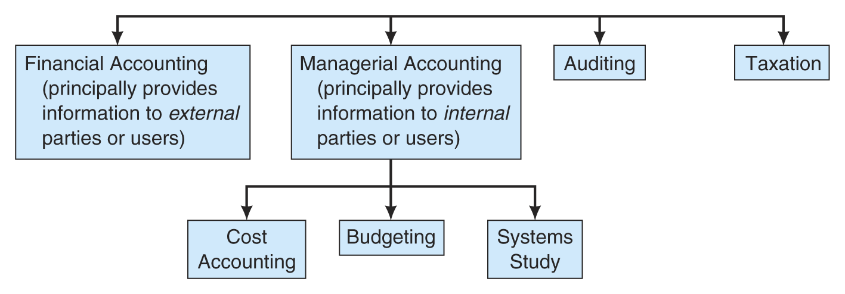
Accounting and IT

Slide 26

Financial Accounting
The objective of financial accounting is
  to provide relevant information to individuals and
  groups outside an organization’s boundaries.
The users include
  investors,
  tax agencies, and
  creditors.
The objectives are achieved through
  preparation of financial statements.

Slide 27
Financial Accounting
Inputs
  transactions are measured in monetary units.
A good audit trail
  information users can follow the flow of data through the system
  managers can follow source document data from input through processing to the output (& vice versa)
The accounting cycle
  parallels the audit trail
  begins with a transaction
  ends with producing financial statements and closing temporary accounts.

Slide 28
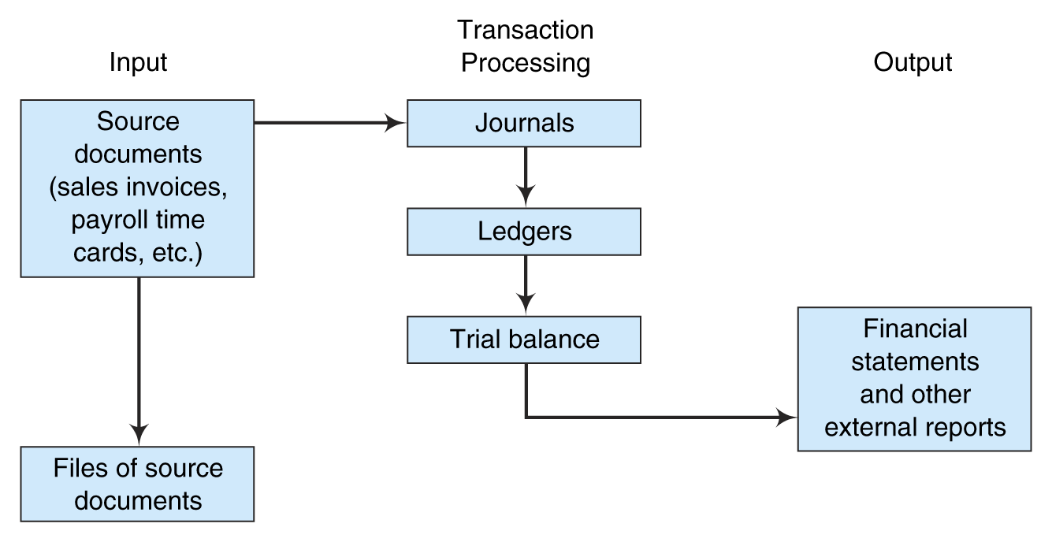
A Financial Accounting
Audit Trail

Slide 29


Financial AIS - Criticisms
& Solutions
Criticism
Did not provide nonfinancial data
Financial statements are periodic. Too much aggregation of information
Data is not interactive - data used in one application are not easily transferable to another
Solutions
Recommended disclosure of non-financial performance measures.
Reporting of disaggregated information tracks sales and many of its expenses continually
Extensible business reporting language (XBRL) is emerging as the language
of choice for interactive data

Slide 30

Managerial Accounting
Objective:
  to provide relevant information to internal
  parties (or users).
Components:
  Cost Accounting
  Budgeting

Slide 31
Managerial Accounting - Features
Managerial Accounting
focuses on accounting information
  for internal parties, such as management,
  not for external investors and creditors.
is mostly forward-looking.
is not regulated by generally accepted accounting principles, nor is mandatory to prepare.

Slide 32
Managerial Accounting - Features
includes both nonmonetary and financial data.
is influenced by many business and nonbusiness disciplines, such as economics, behavioral science, quantitative methods
is flexible and frequently involves nonroutine reporting.

Slide 33

Cost Accounting
Cost accounting assists managers in the organization’s measuring and controlling the costs associated with:
  acquisitions
  processing
  distribution
  selling activities.

Slide 34
Cost Accounting
Activity-based costing systems assign
  overhead to products based on cost drivers.
Corporate performance measurement
  Identifies unfavorable performance
  Traces to the department or individual
  responsible for the inefficiencies.
  Allows management to take
  immediate corrective action.

Slide 35
Cost Accounting
The Balance Scorecard approach uses performance measurements in:
  financial performance
  customer knowledge
  internal business processes
  learning and growth

Slide 36

Budgeting
Definition
  a financial projection for the future
  and valuable managerial planning aid
Useful
  for managerial control and to compare
  actual results to budgeted results.
Influence
  on all the subsystems within an organization.

Slide 37
Auditing
Traditional role
  to evaluate the accuracy and completeness of a corporation’s financial statements
Present role
  in the assurance business; the business of providing third-party testimony that a client complies with a given statute, law, or similar requirement

Slide 38
Auditing
CPA Trust Services
  include online privacy evaluations, security audits, testing the integrity of information processing systems
  assessing availability of IT services, and systems confidentiality testing.

Slide 39
Assurance Services identified by the AICPA Special Committee
Risk Assessment
  Provide assurance that an organization's set of business risks is comprehensive and manageable.
Business Performance Measurement
  Provide assurance that an organization’s performance measures beyond the traditional measures in financial statements are relevant and reasonable for helping the organization to achieve its goals and objectives.
Information Systems Reliability
Provide assurance that an organization’s system has been designed to provide reliable information for decision making

Slide 40
Assurance Services identified by the AICPA Special Committee
Electronic Commerce
  Provide assurance that an organization's doing business on the internet can be trusted to provide the goods and services they promise, and that there is a measure of security provided to customers.
Health Care Performance Measurement
  Provide assurance to health care recipients about the effectiveness of health care offered by a variety of health care providers.
Eldercare Plus
  Provide assurance that various caregivers offering services to the elderly are offering appropriate and high-quality services.
Notes:
Caregivers:مانح الرعايه

Slide 41

Taxation
Taxation software
  are examples of AISs
  enable users to create and store copies of trial tax returns
  help examine consequences of alternate tax strategies
  print specific portions of a return
  transmit completed copies of a tax return
  to the appropriate government agency
Notes:
trial tax: نسخ تجريبه لاقرارات الضريبه

Slide 42
Taxation
Professionals can use taxation software
  to access electronic tax libraries on CDs or online
  to research challenging tax questions
  to get more up-to-date tax information
  access databases of federal and state tax laws, tax court rulings, court decisions,
  and technical advice.

Slide 43

Careers in Accounting Information Systems
Systems consultants
provide help with information systems in
  Designing information systems,
  selecting hardware and software, or
  reengineering business processes.
Value-added resellers (VARs)
sell a certain software program and
provide consulting services to companies.

Slide 44

Careers in Accounting Information Systems
Information systems auditors
analyze risks associated with computerized information systems
can show organizations ways that their computer systems could be penetrated
can be licensed as Certified Information Systems Auditors (CISA)
can obtain the certification from the Information Systems Audit and Control Association (ISACA)

Slide 45
Planning for Disaster
Planning assures that operations continue after disaster
IT particularly vulnerable to man-made attacks, such as viruses and worms
Under auditing standard No. 60, absence of disaster plan needs to be reported.
Plan needs to be tested regularly.
Notes:
Vulnerable: غير حصين

